Slide 1
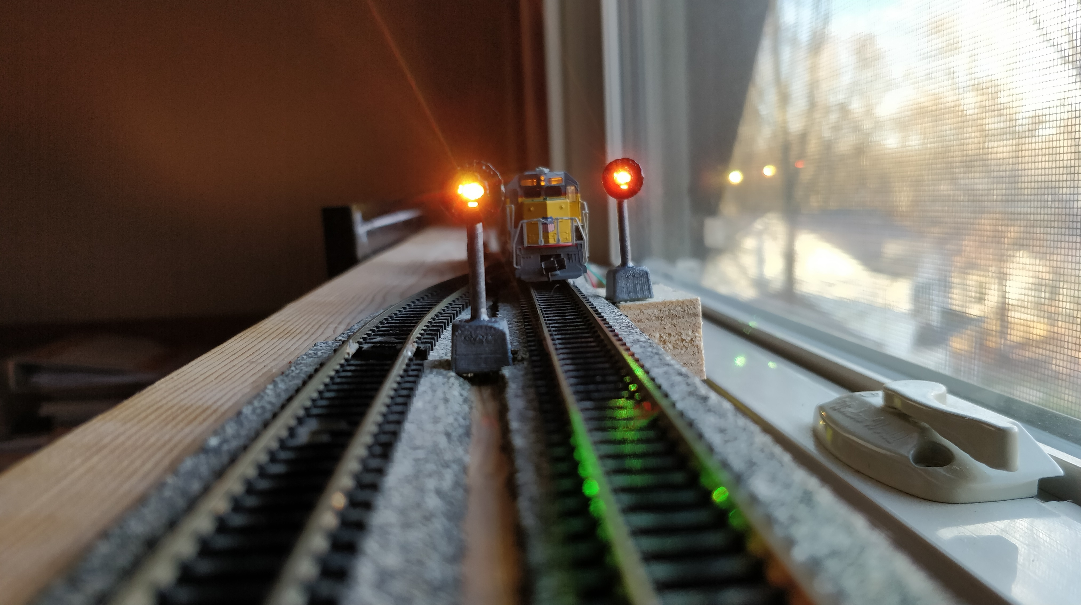
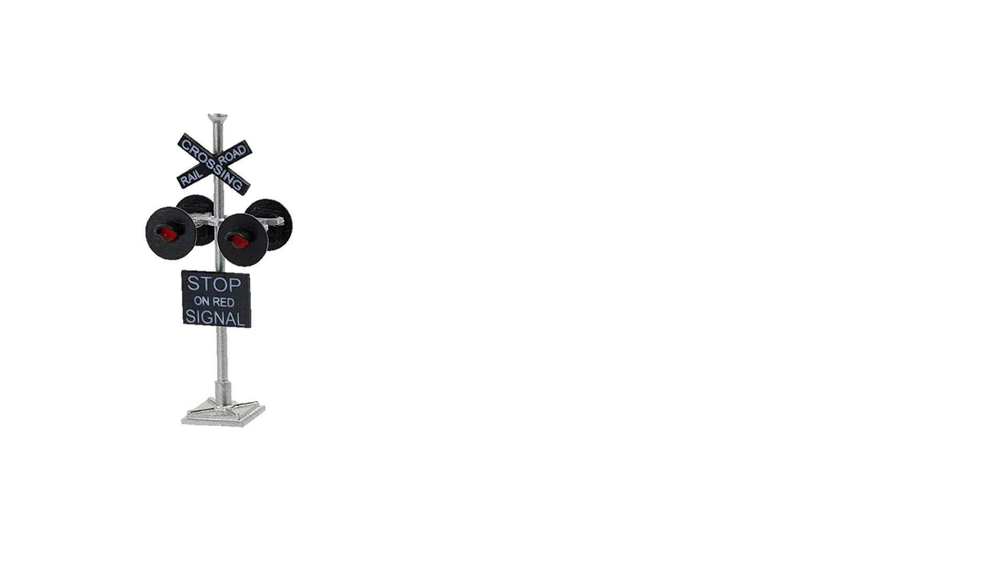
Signaling
System
&
Light Effects

Slide 2
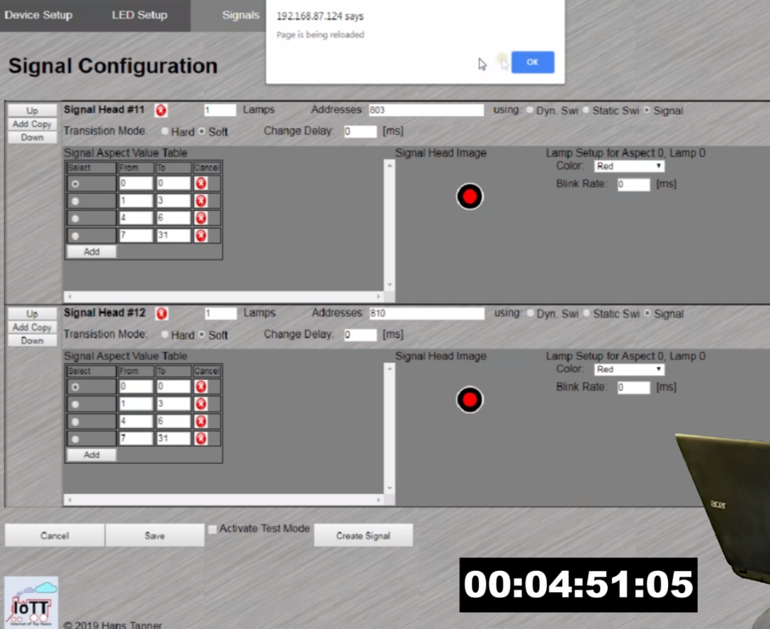

Slide 3
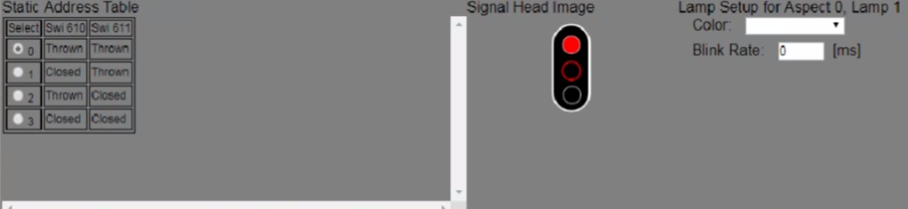

Slide 4
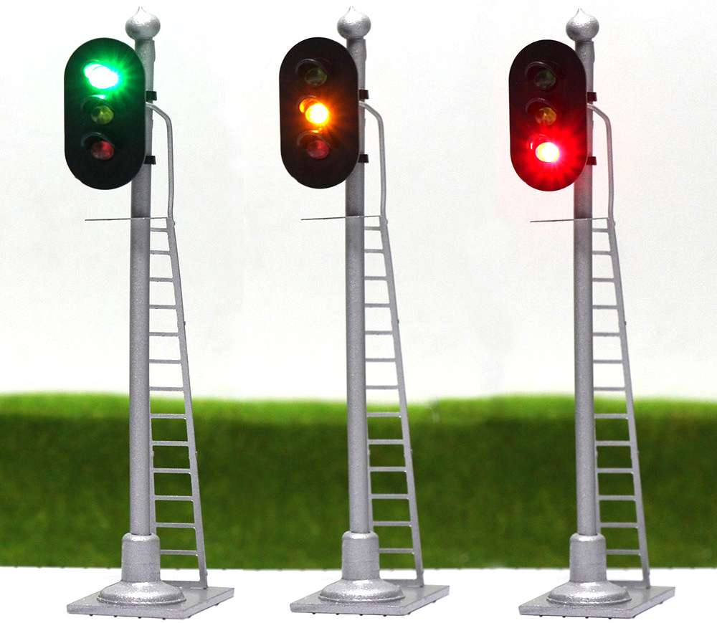

Slide 5
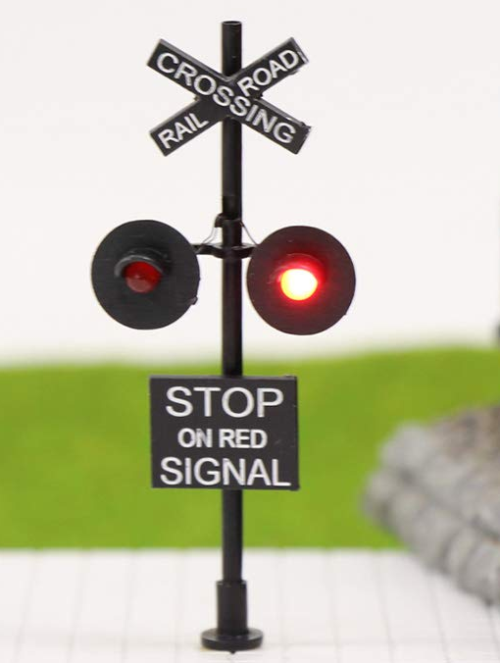

Slide 6
Signal System Capabilities
Number of Signals only limited by device memory. 200+ signals are realistic with just one signaling device
Can receive aspect commands via LocoNet, DCC Track Signal, or Wifi (MQTT Gateway)
Supports full range of Switch Addresses as well as Extended Accessory Decoder commands (NMRA Signal commands supporting 36 Aspects)
All signals can be different regarding number of LED’s, number of aspects, colors, etc.
Supports up to 4 switch addresses per signal for a maximum of 16 Aspects in static or 8 Aspects in dynamic mode
Simple 3-wire cable for serial connection chain to all signals
Graphical user interface with built-in simulator for the design of aspects of each signal, depending on number of lamps on the signal

Slide 7
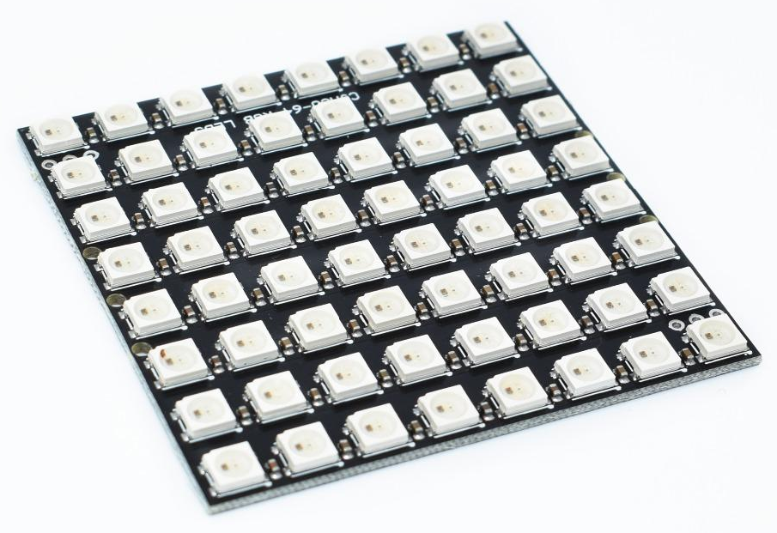

Slide 8
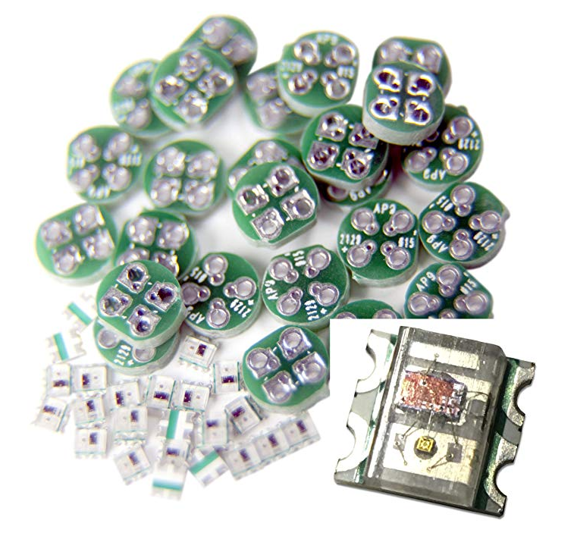
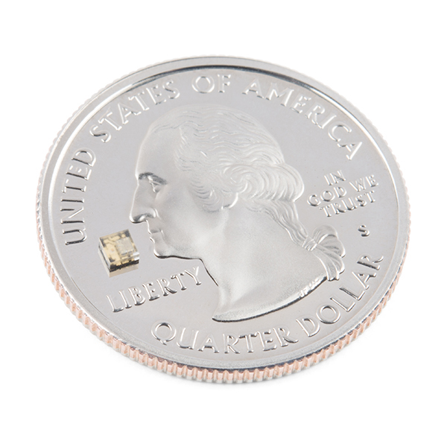

Slide 9
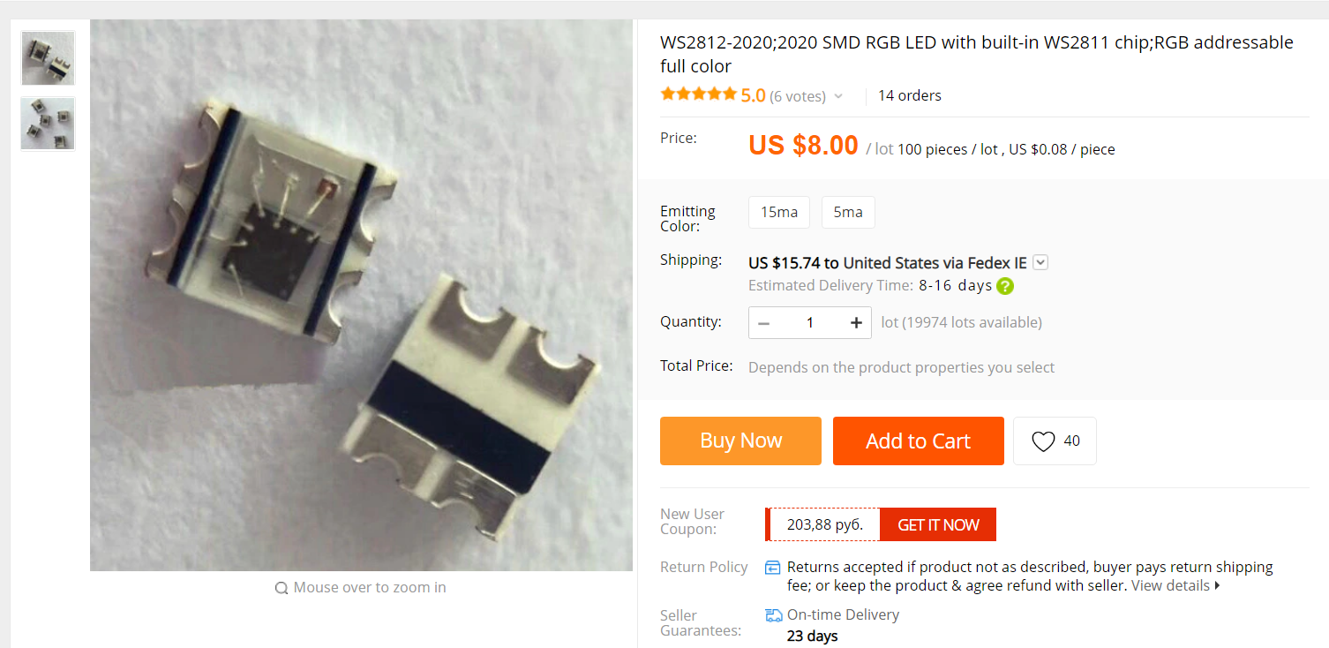

Slide 10
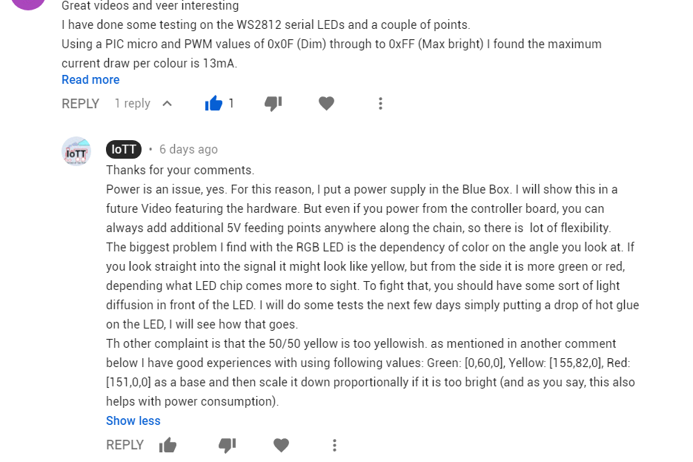

Slide 11
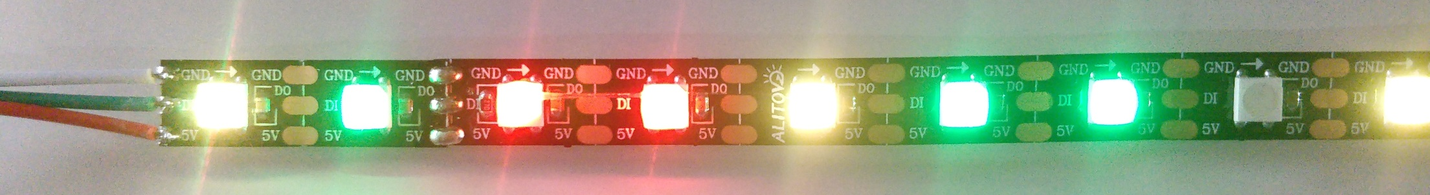
Loctite Go2
Elmer’s Glue
Hot Glue (2mm)
Hot Glue (0.5mm)
Elmer’s, 5 Layers
Elmer’s, 4 Layers
Best

Slide 12
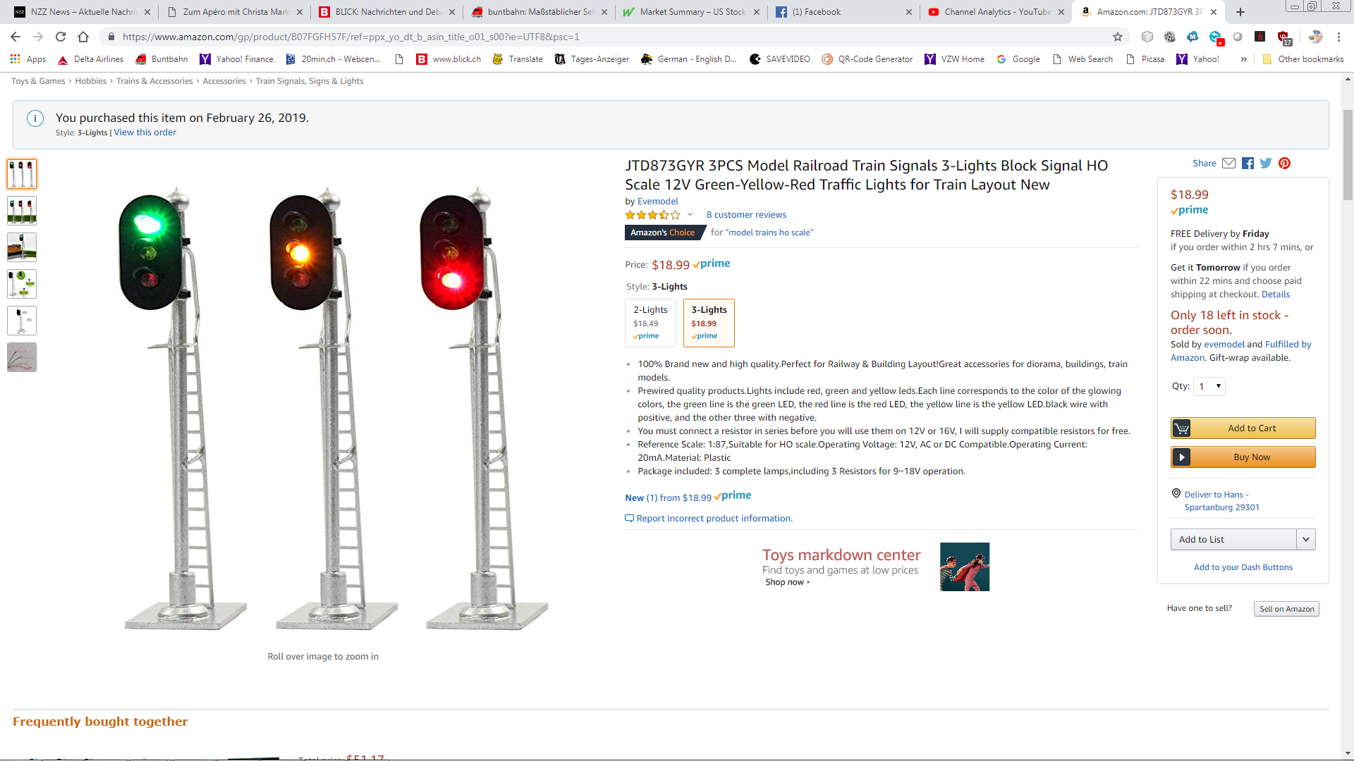

Slide 13
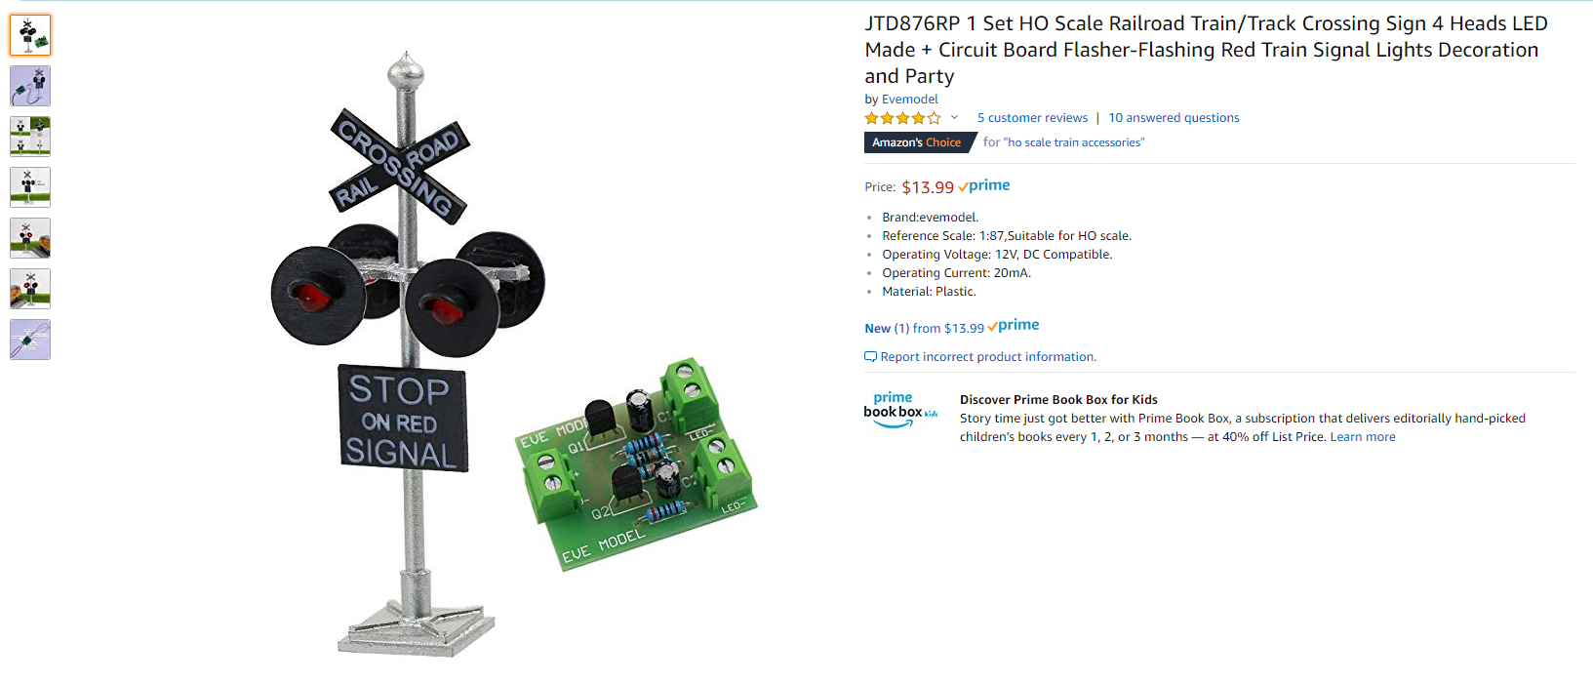

Slide 14
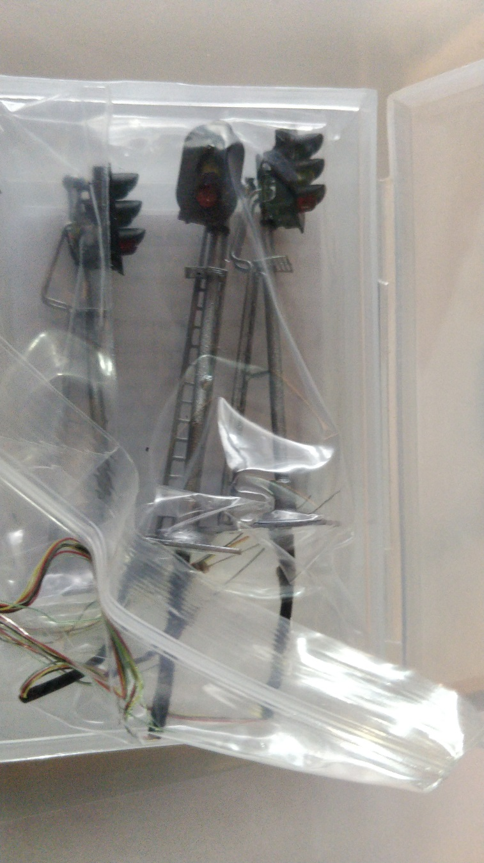
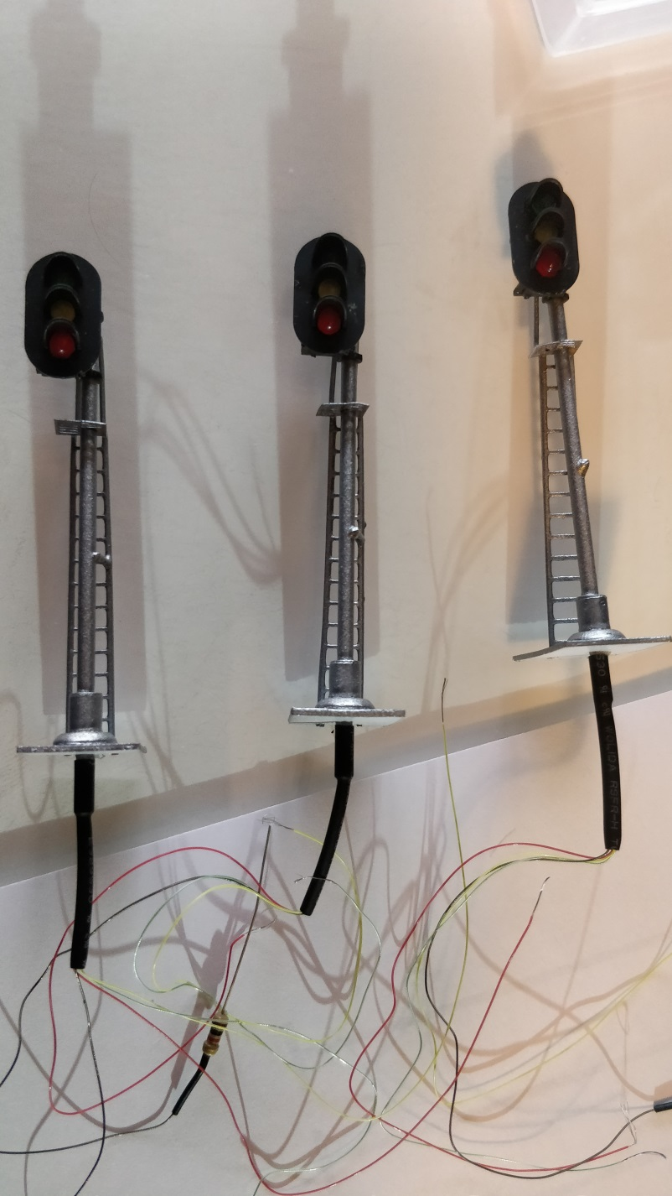
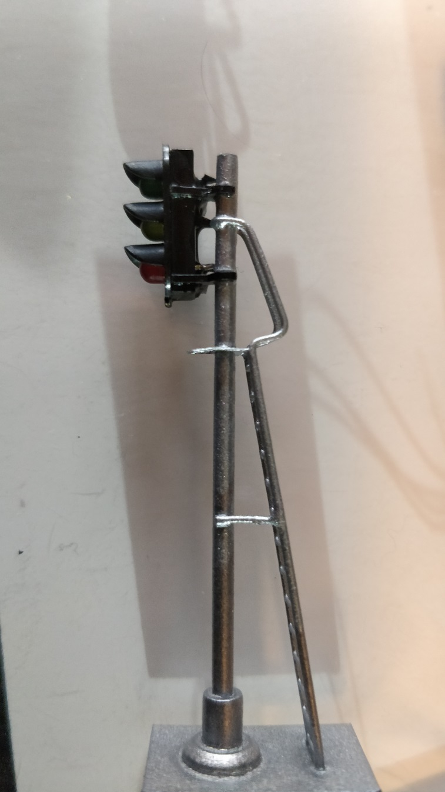

Slide 15
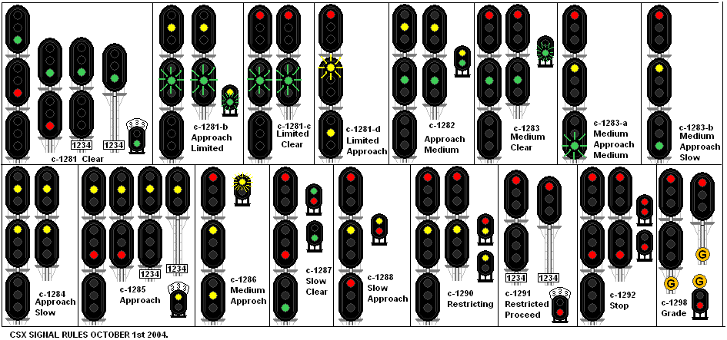

Slide 16
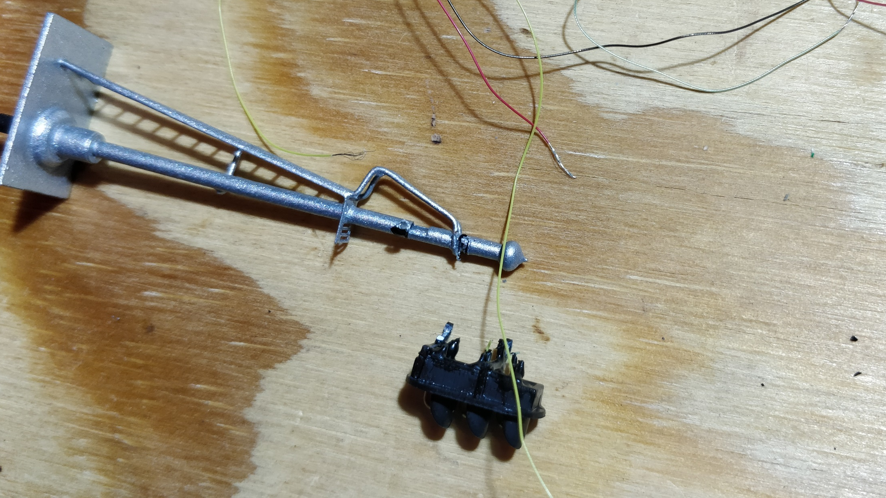

Slide 17
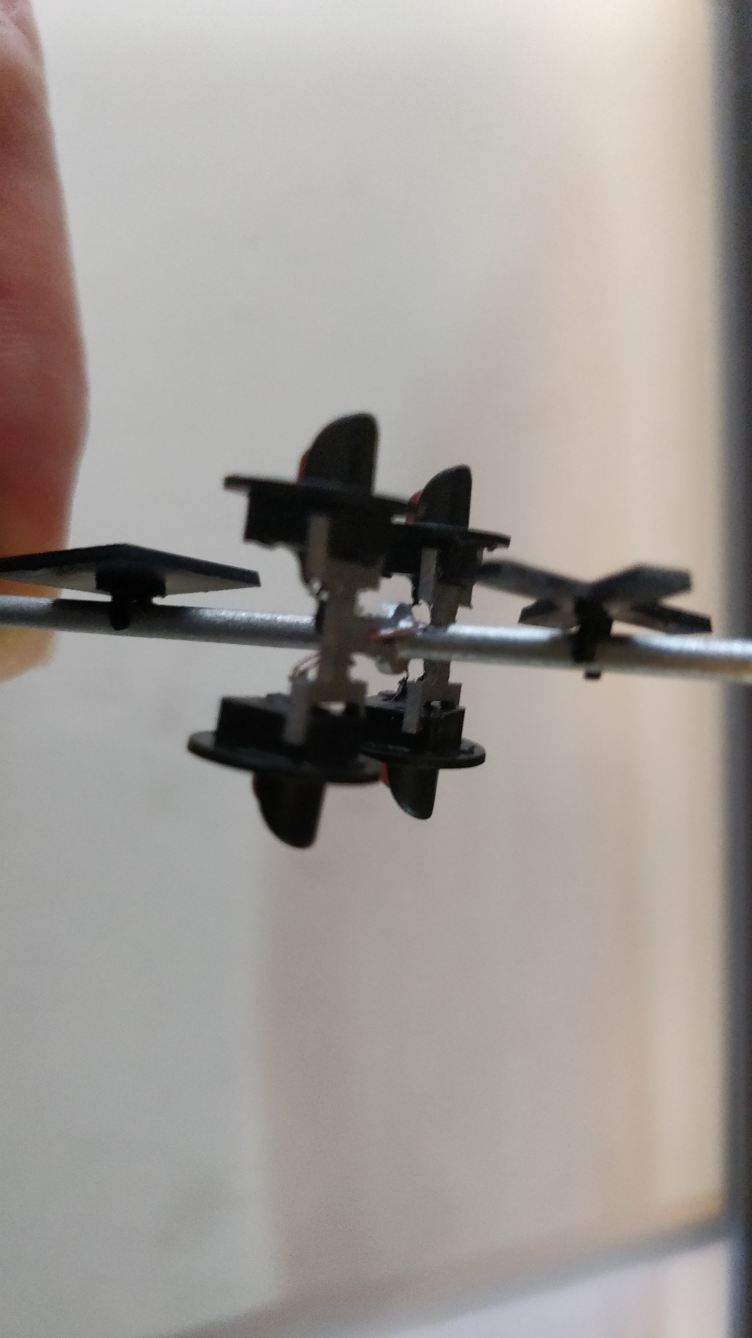
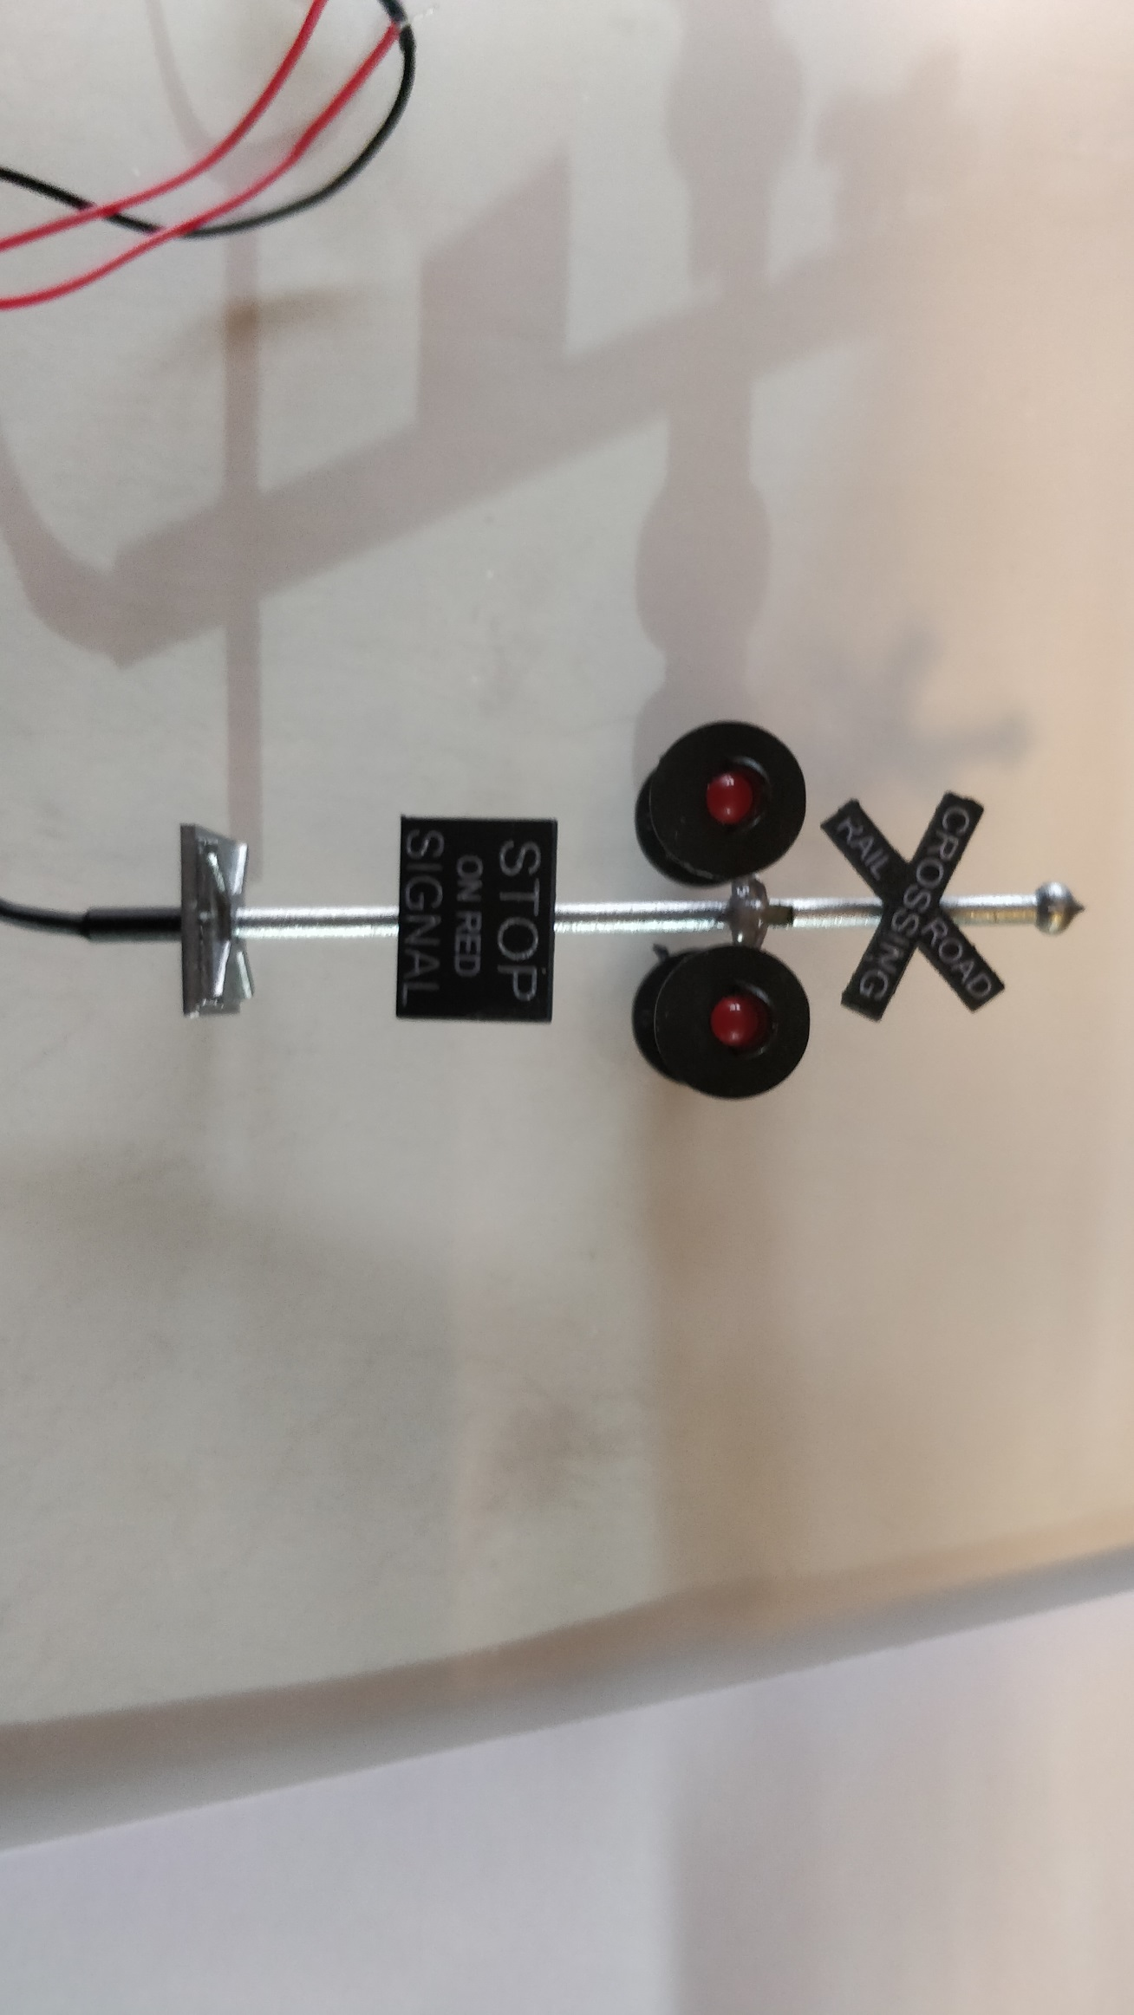
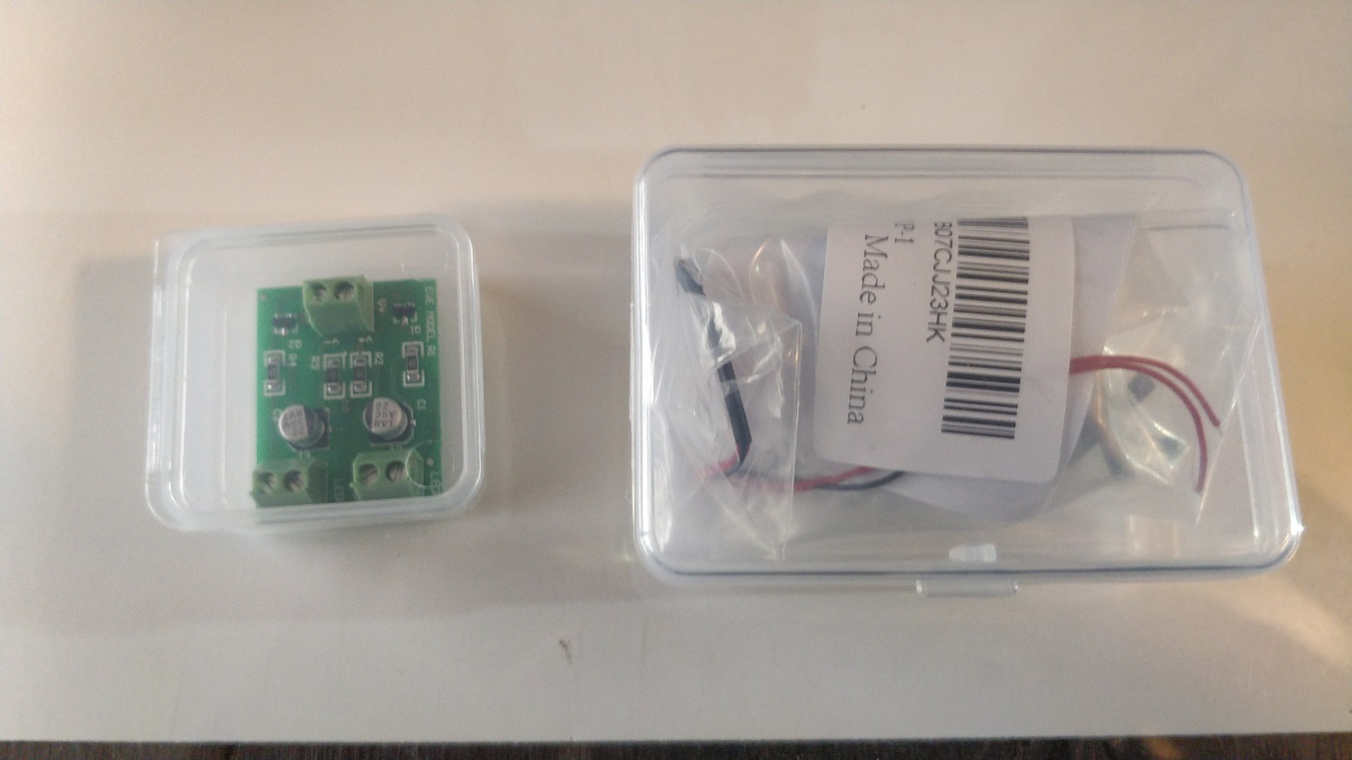

Slide 18
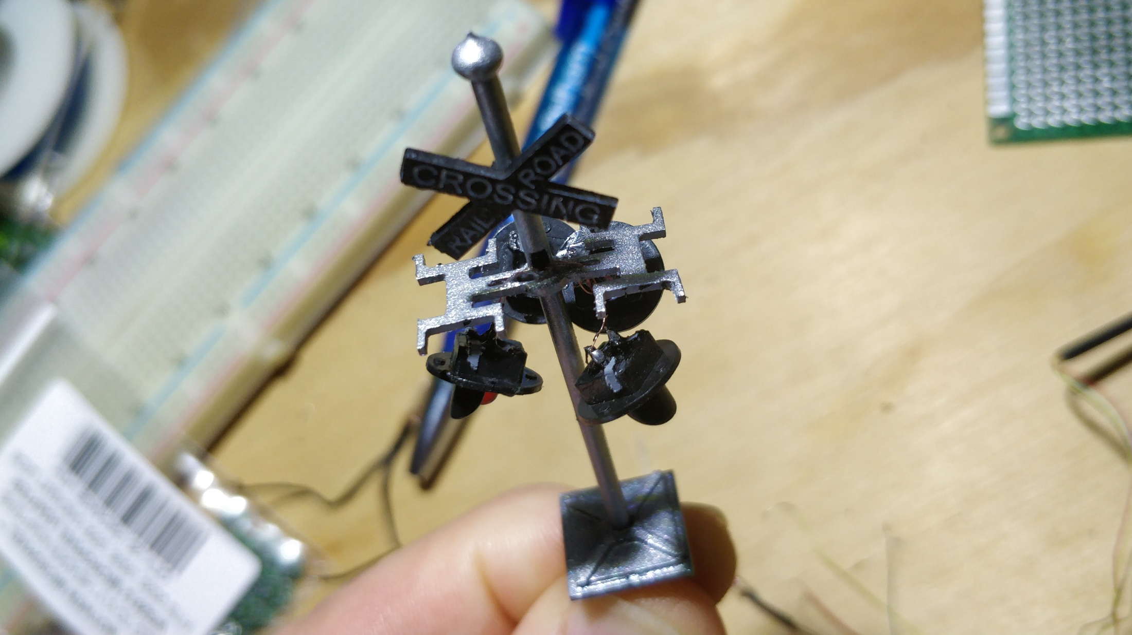

Slide 19
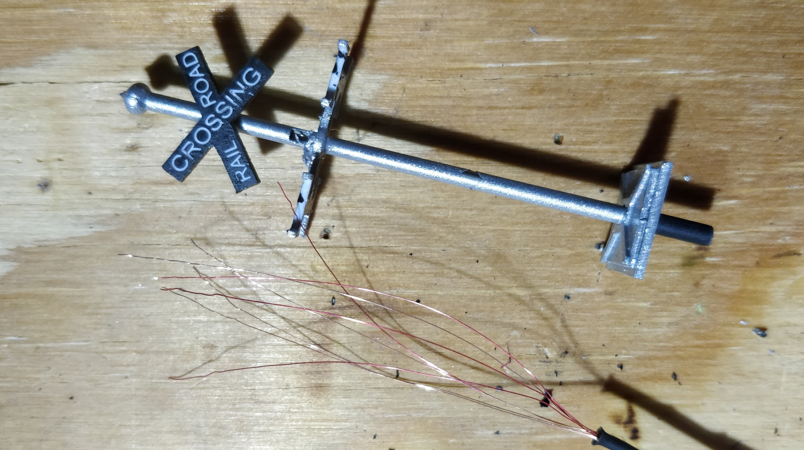

Slide 20
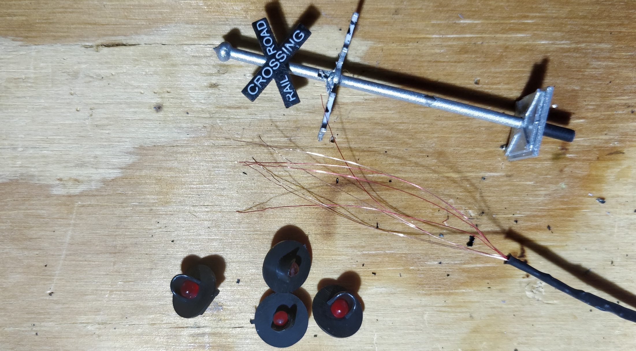

Slide 21
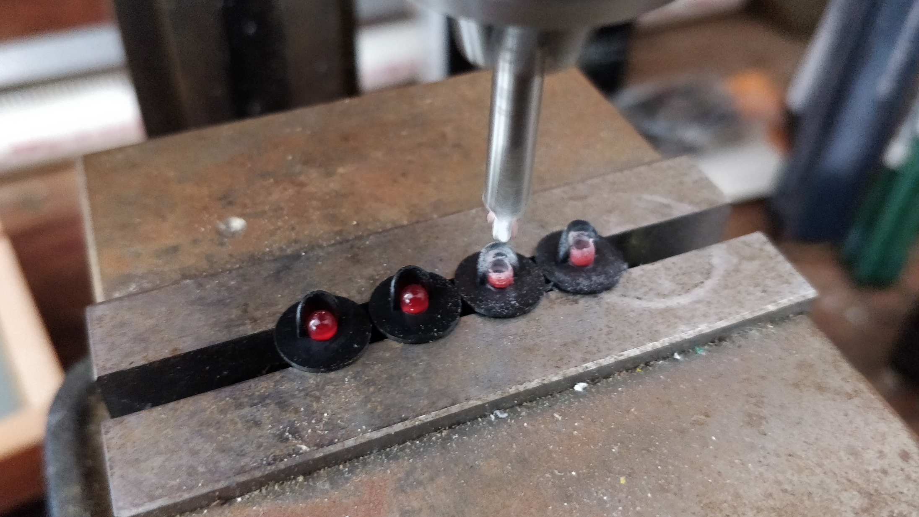

Slide 22
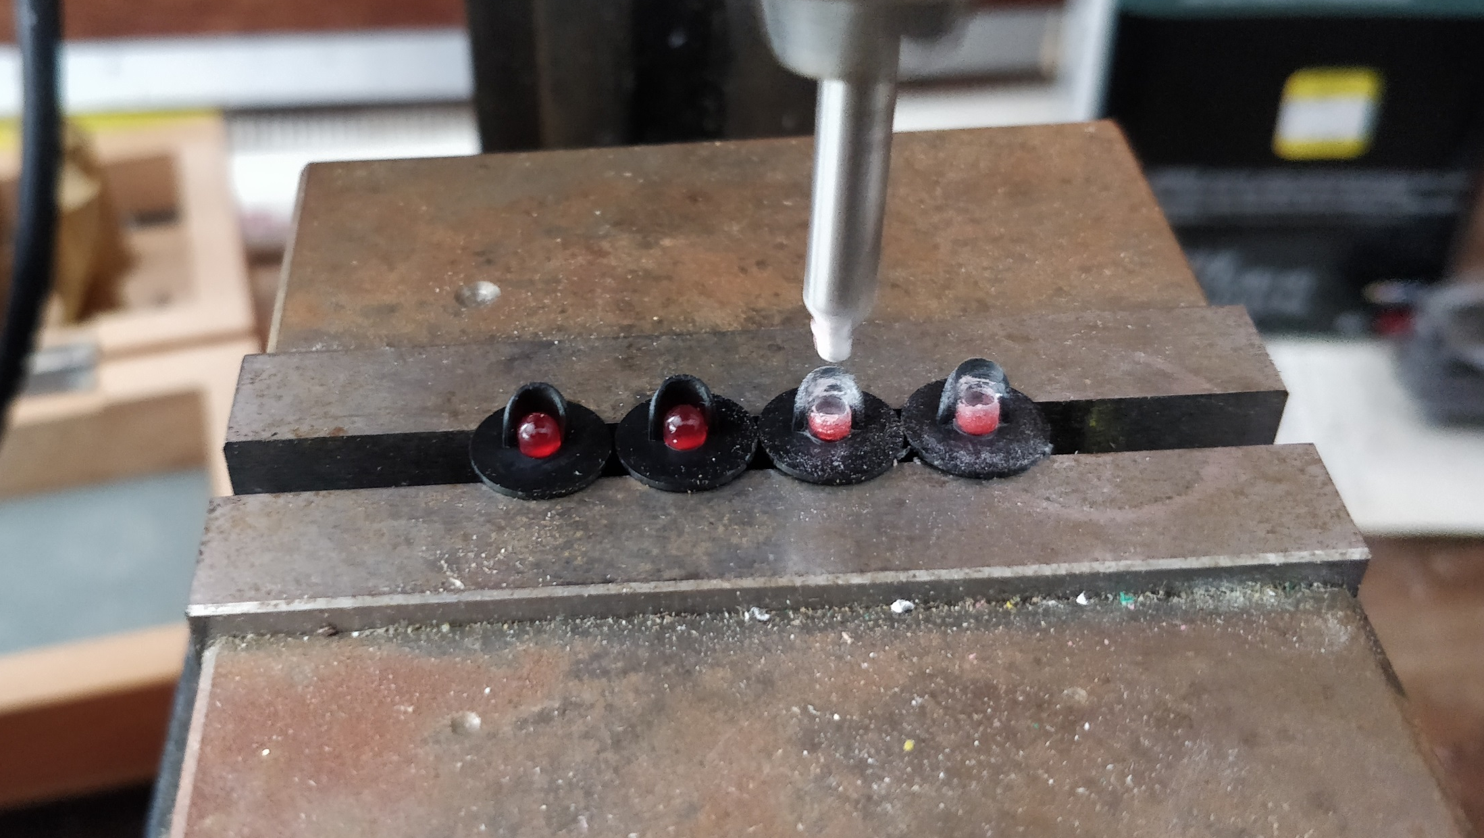

Slide 23
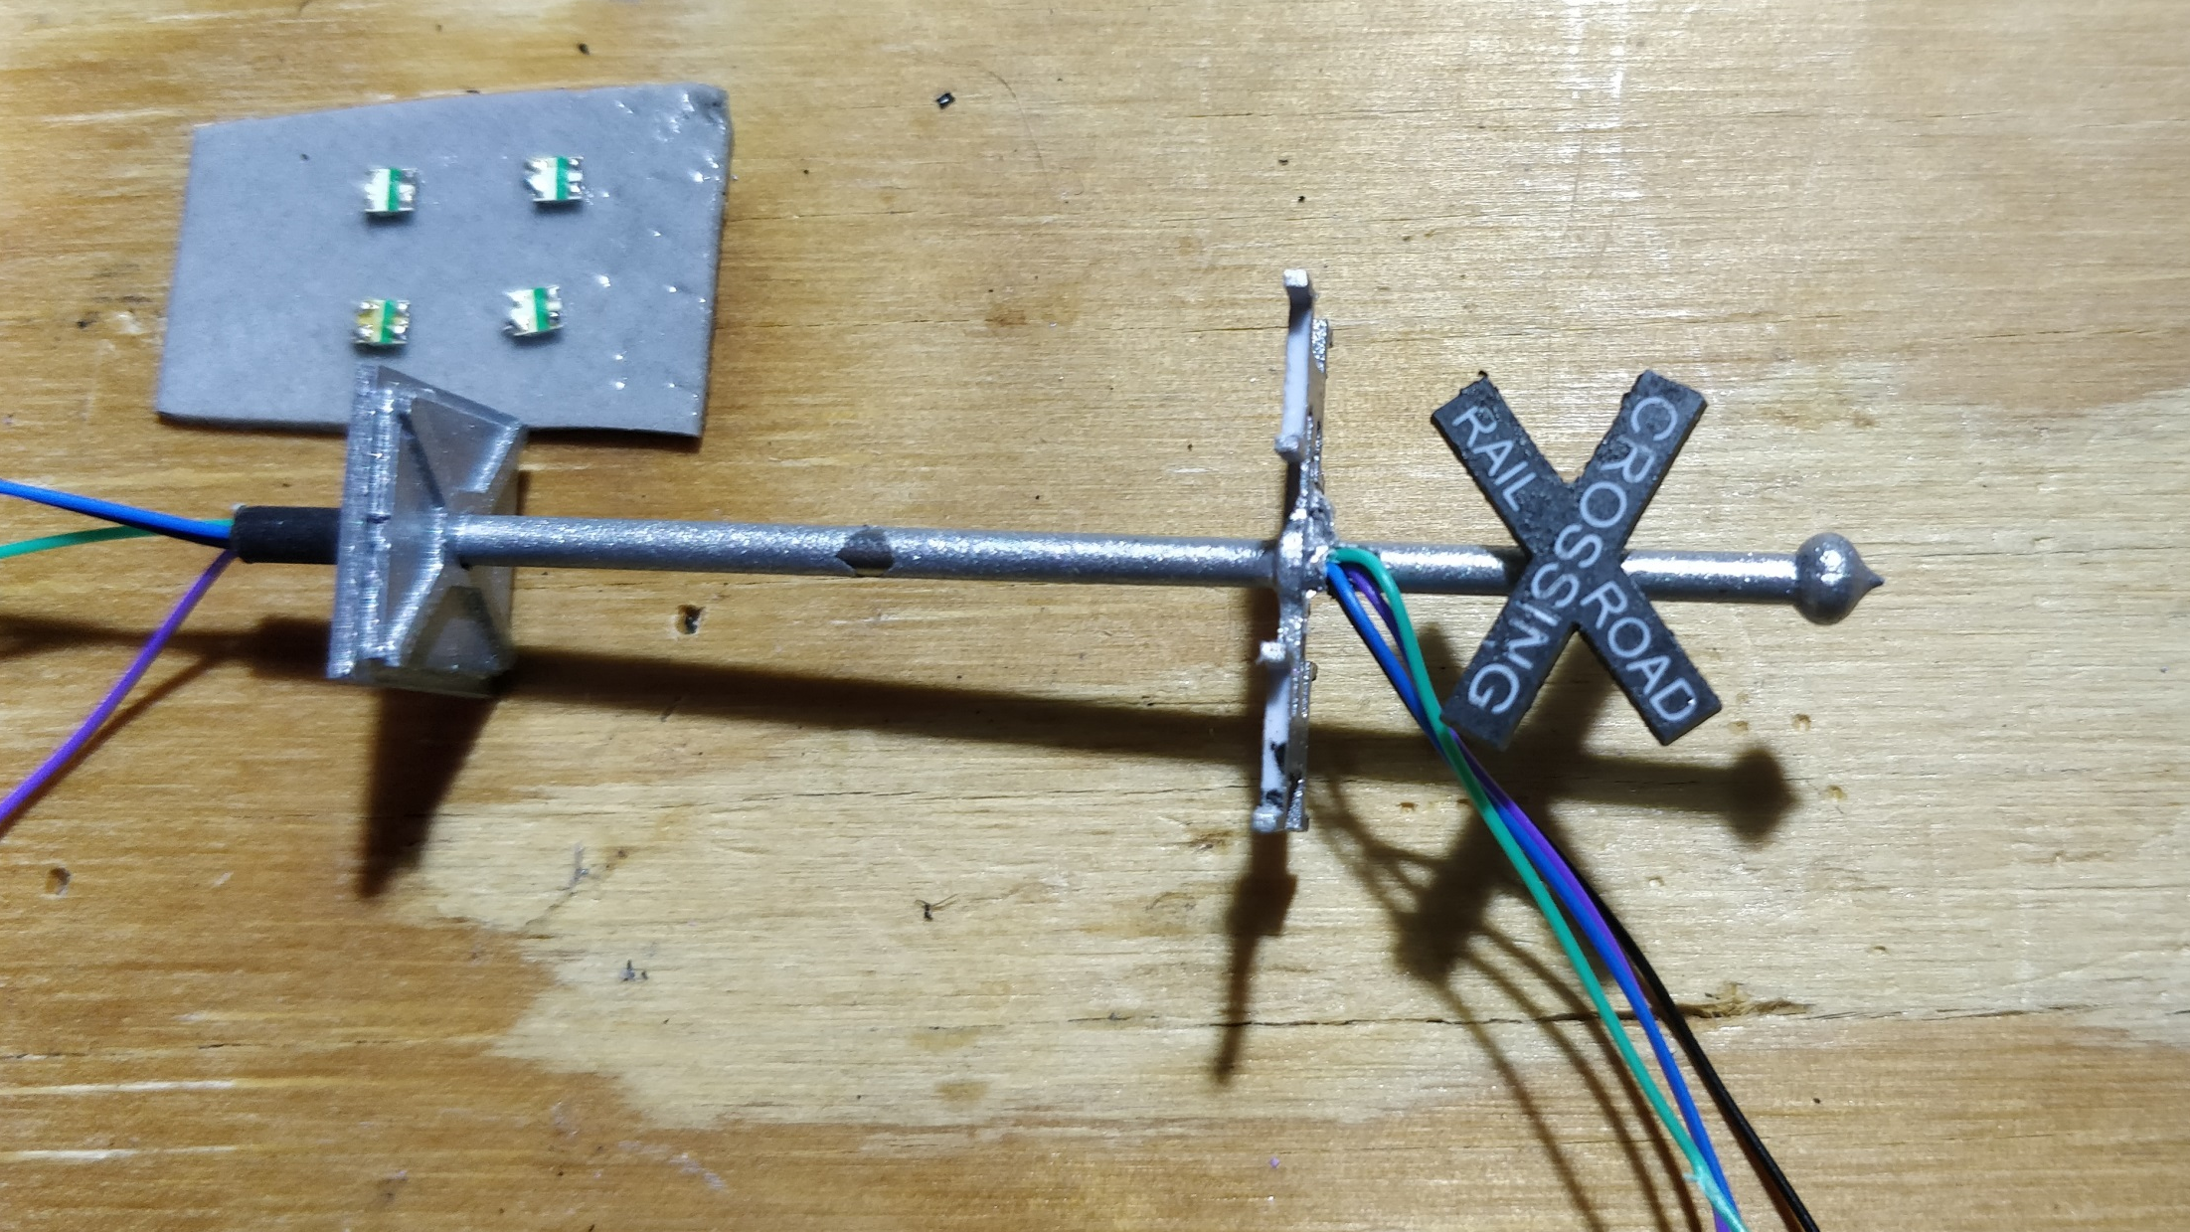

Slide 24
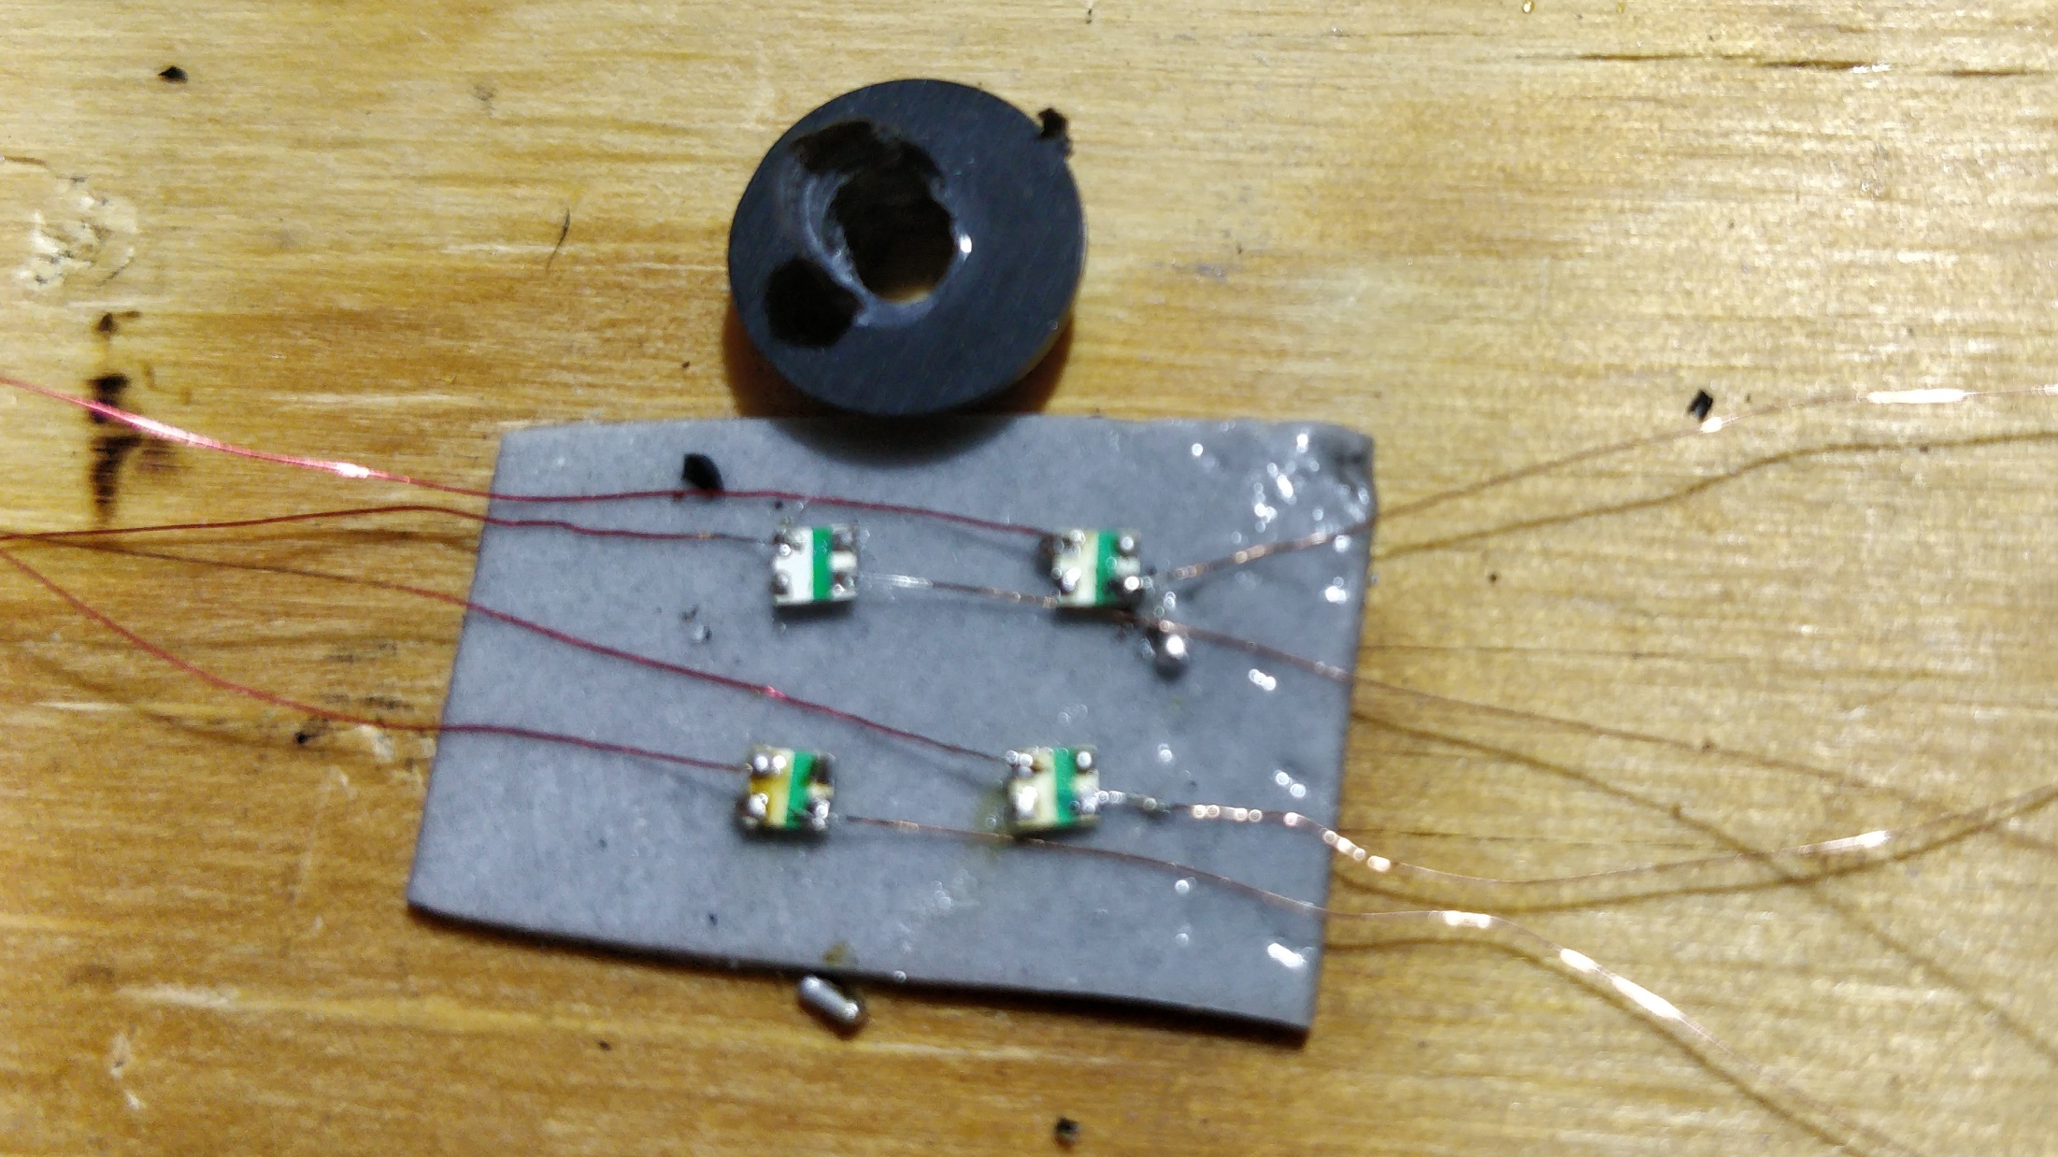

Slide 25
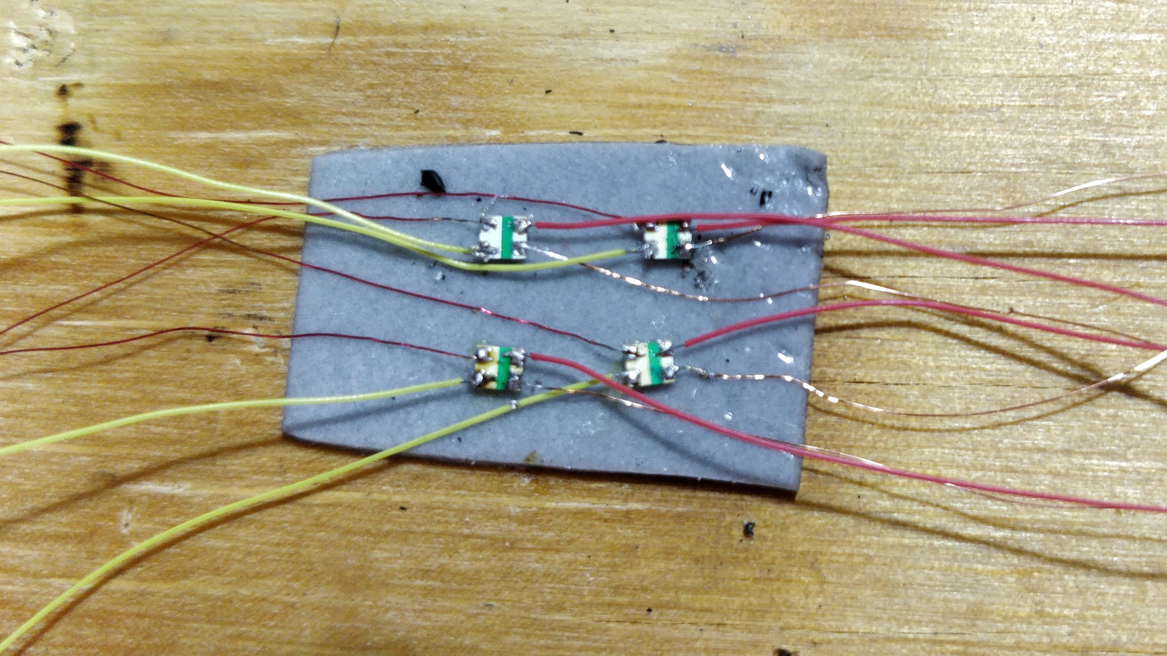

Slide 26
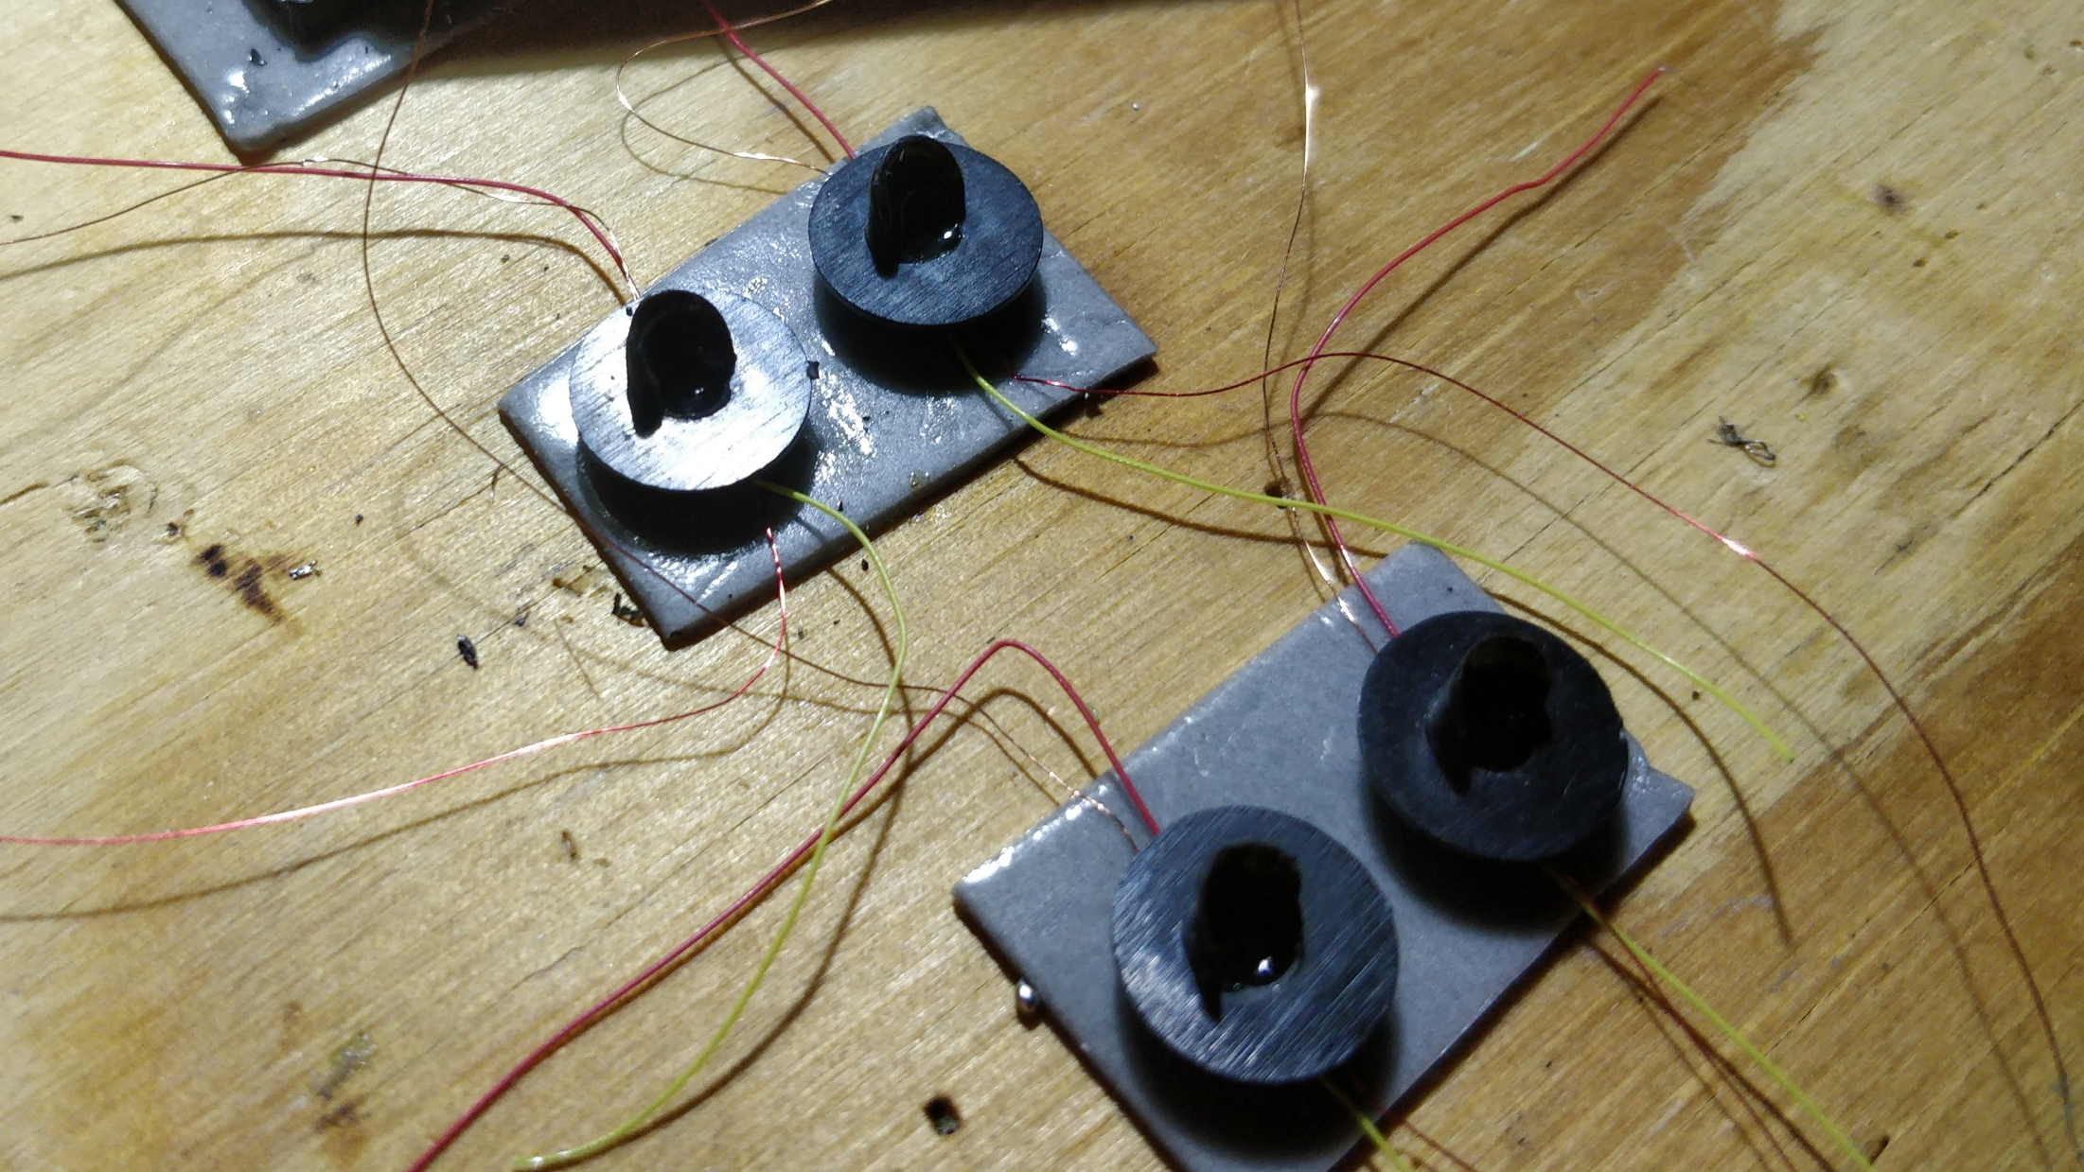

Slide 27
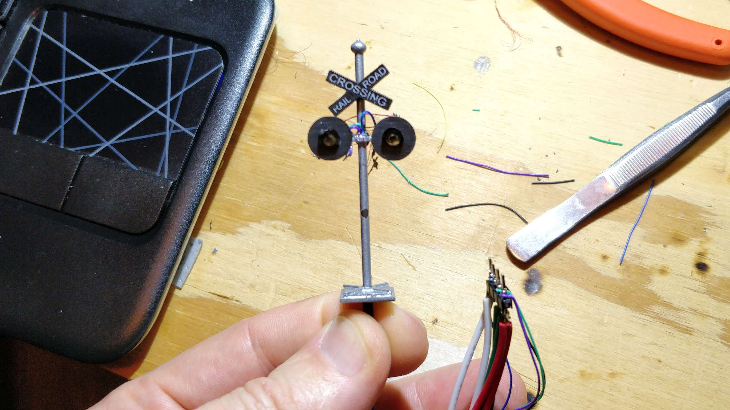

Slide 28
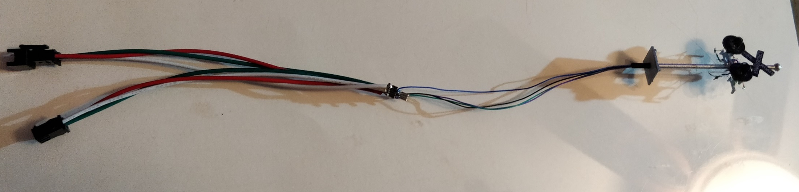
Wire Wrap Wires
5V
GND
Data in
Data out
Standard Light Chain Connectors
Pin Header

Slide 30
800 802 811 804 809 807 806 808 805 801 803 810
1 2 3 4 5 6 7 8 9 10 11 12
Aspects: Color: Value:
Stop: Red 0
Slow Approach: Yellow 1-3
Medium Approach: Yellow blinking 4-6
Clear: Green 7-31

Slide 31
Stop
Slow
Approach
Medium
Approach
Clear
NORAC Aspect Displays
http://rail.pgengler.net/signals/fixed_norac.html

Slide 32
800 610,611 802 811 804 809 807 806 808 805 801 803 810
1 2 3 4 5 6 7 8 9 10 11 12

Slide 33
800 802 610,611 811 804 809 807 806 808 805 801 803 810
1 2 3 4 5 6 7 8 9 10 11 12 13

Slide 34
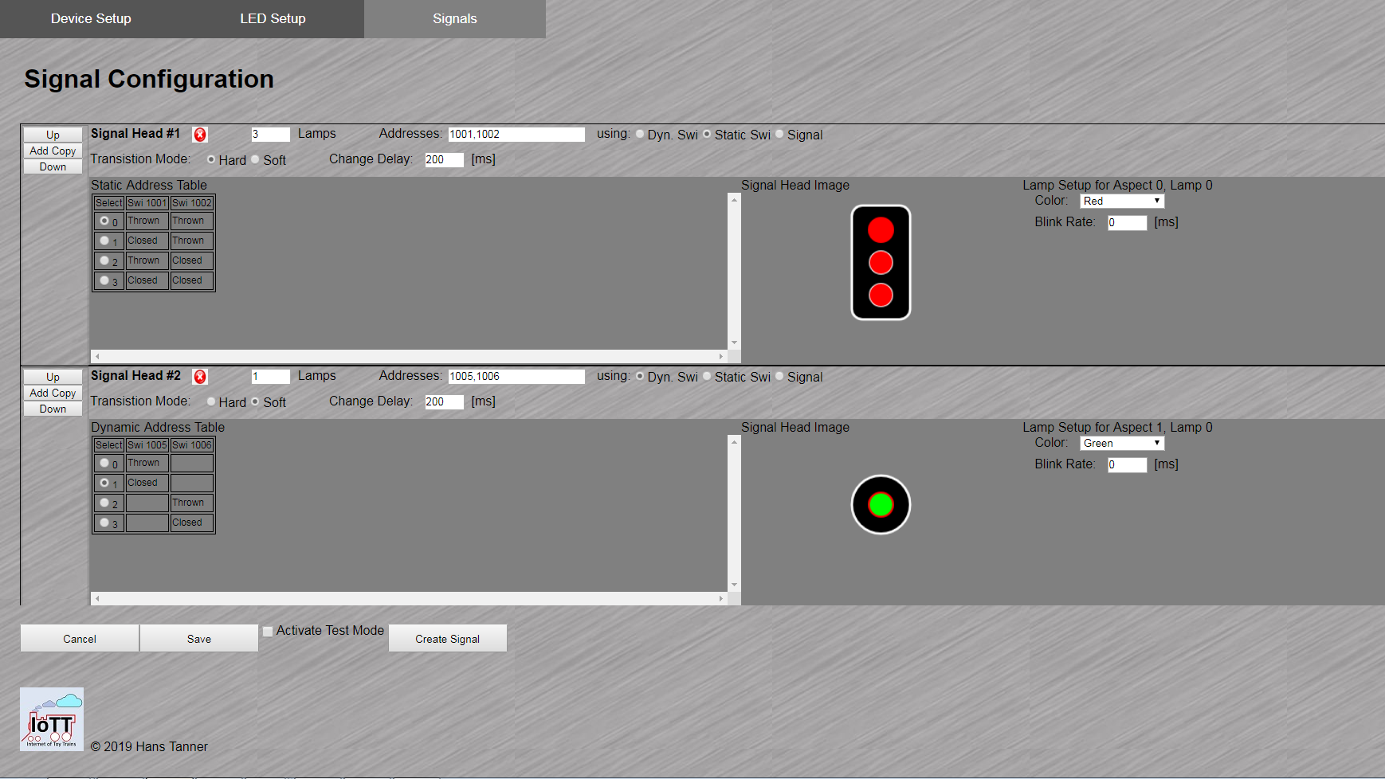

Slide 35
Summary
Just another example how using Neopixel LED’s make the signaling hardware more flexible, faster to install, and less complex to configure
The Blue Box controller can generate a wide variety of lighting effects with very little configuration efforts
The display capabilities of the WS2812 LED chain are impressive

Slide 36
WS2812 Pixel Matrix (Aliexpress): https://www.aliexpress.com/item/5pcs-WS2812-LED-5050-RGB-8x8-64-LED-Matrix-for-Arduino/32653027272.html?spm=a2g0s.9042311.0.0.6e434c4dQC3KNf
WS2812-2020 (Amazon): https://www.amazon.com/gp/product/B07MT5B24F/ref=ppx_yo_dt_b_asin_title_o00_s01?ie=UTF8&psc=1
3 Light Signal (Amazon): https://www.amazon.com/gp/product/B07FGFH57F/ref=ppx_yo_dt_b_asin_title_o01_s00?ie=UTF8&psc=1
Crossing Signal (Amazon): https://www.amazon.com/gp/product/B07CJJ23HK/ref=ppx_yo_dt_b_asin_title_o01_s00?ie=UTF8&psc=1
NORAC Aspect Displays: http://rail.pgengler.net/signals/fixed_norac.html
ESP32 Software on Github: https://github.com/tanner87661/IoTT-Video14
Additional Materials on Github: https://github.com/tanner87661/IoTT-Video15
Layout Intro Sequence Outdoor Layout: Beat Deola, Switzerland​
Layout videos taken at Apple Valley MR Club: https://www.avmrc.com/

Slide 37




IoTT
Internet of Toy Trains

